Slide 1

COMPARE.IT
BINARY BANDITS
BOOYSEN HAYLEY
GIBENDI BLESSING
KÖHLER DIVO
MAHLANGU TSHEGOFATSO
MARODI JESSICA
PHOSA NOMZI
EST. 2025
The only type of comparison that doesn’t steal your joy
1

Slide 2
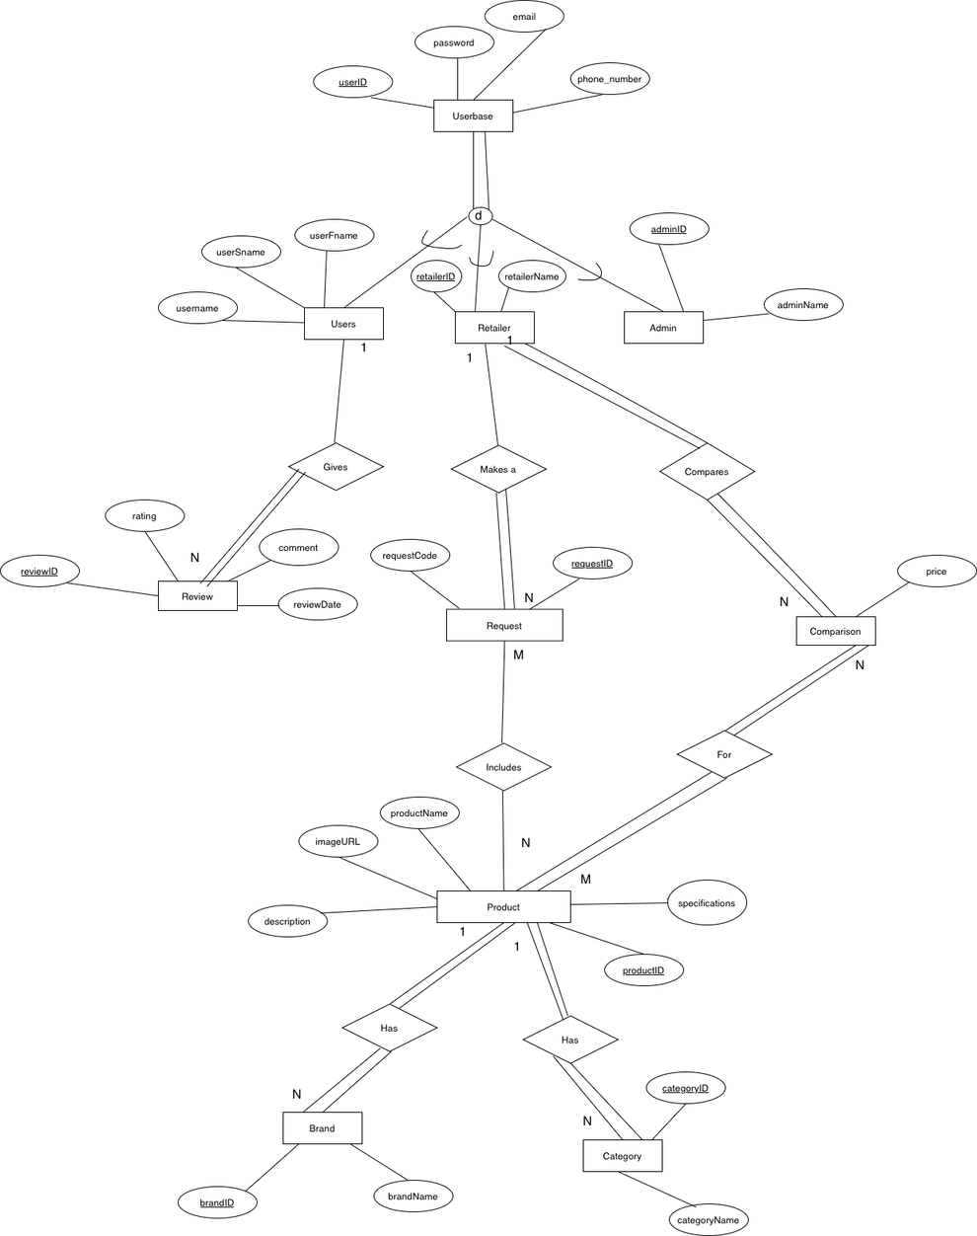
(E)ER
DIAGRAM
2

Slide 3
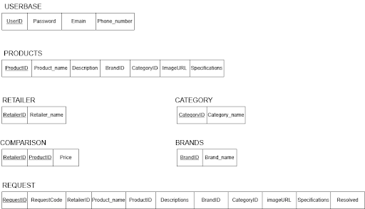
(E)EER DIAGRAM → RELATIONAL MAPPING
Step 1: Mapping of Regular Entities
3

Slide 4
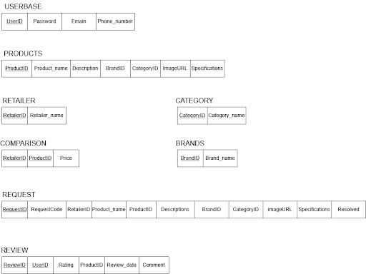
(E)ER DIGRAM → RELATIONAL MAPPING (CONT.)
Step 2: Mapping of Weak Entities
4

Slide 5
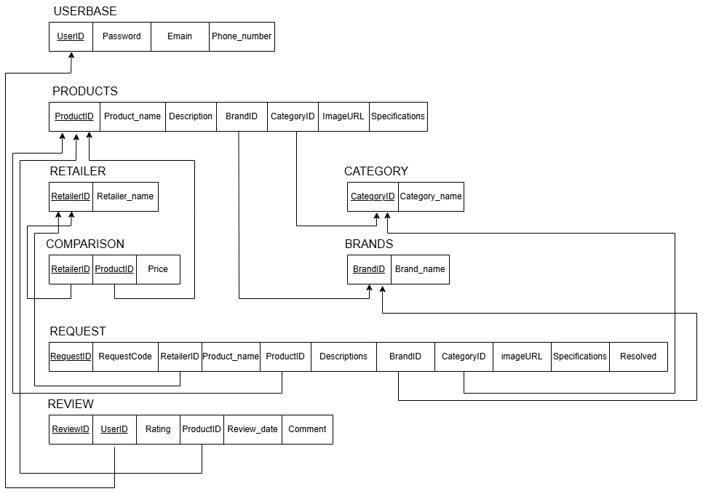
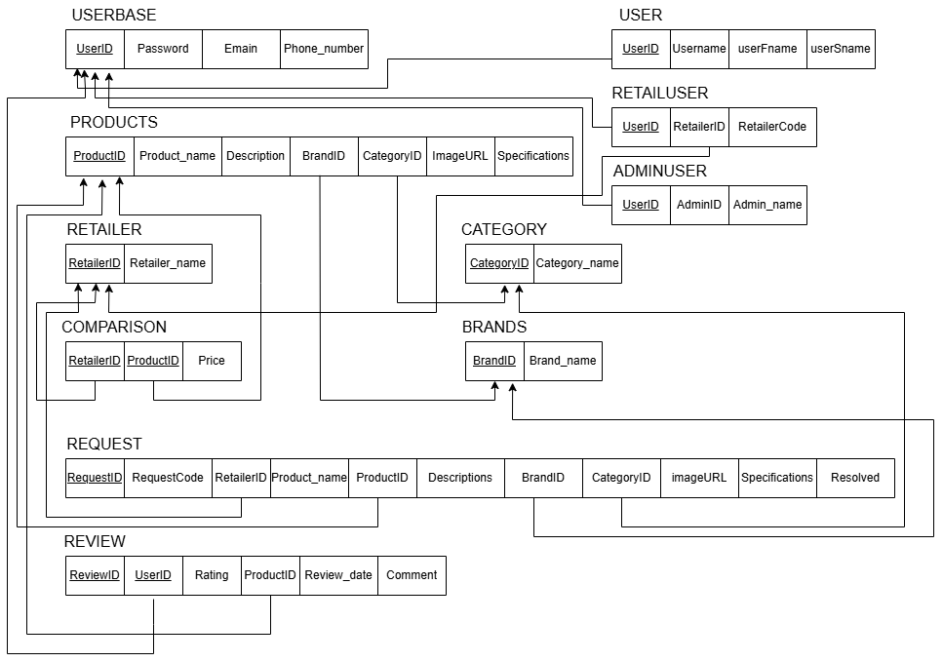
(E)ER DIGRAM → RELATIONAL MAPPING (CONT.)
Step 4: Mapping Binary 1:N Relationsships
5

Slide 6
(E)ER DIGRAM → RELATIONAL MAPPING (CONT.)
Step 8A: Mapping multiple relations - superclass and subclasses
6

Slide 7
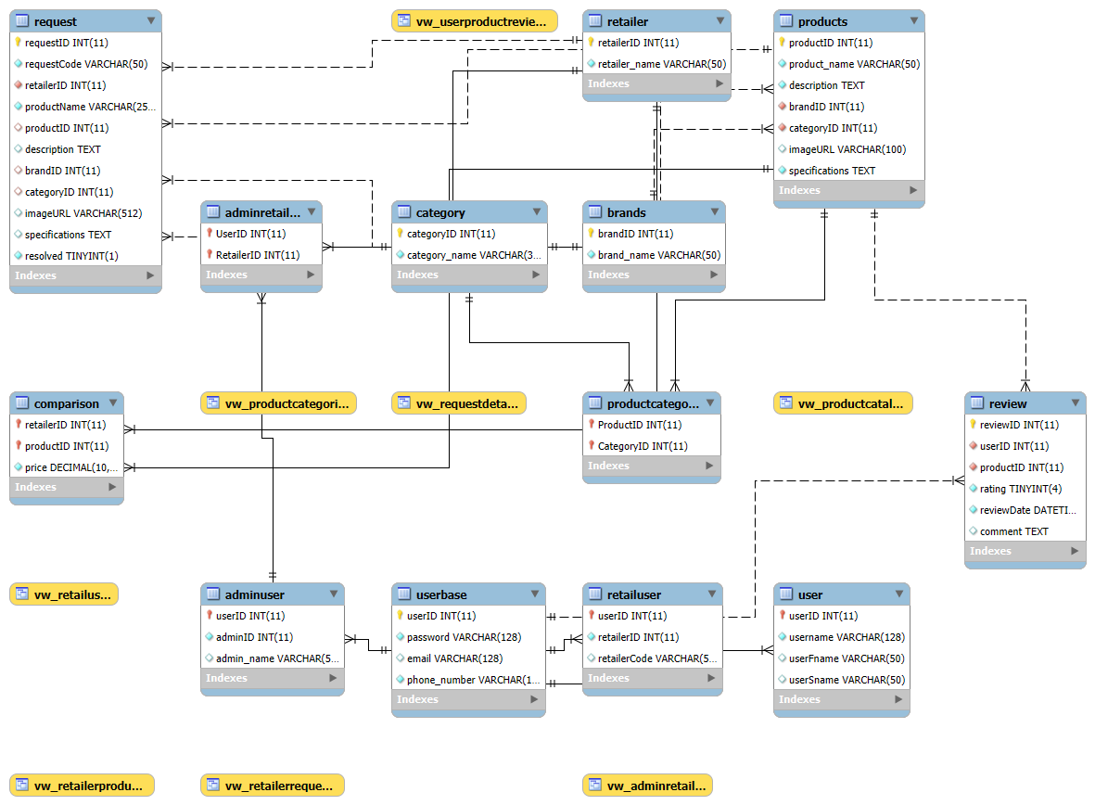
RELATIONAL SCHEMA
7

Slide 8
Web-Based Application Demonstration
8

Slide 9

GITHUB USAGE
x
BINARY BANDITS
9

Slide 10
QUESTIONS?
10

